Slide 1

Lecture 12: Canvas & FXML
WRPV301: Advanced Programming
Dr Simone Beets

Slide 2

Canvas

Slide 3
Canvas
Sometimes you need to draw everything yourself
Standard controls don’t do the job
Creating a new control, e.g., a new type of chart
Creating interactive applications such as a game
All controls have a Canvas
A Canvas lets you
Draw individual pixels, lines, circles, polylines, apply shading, draw images onto it, do operations (such as AND, NOT, XOR…), render 3D objects…
https://docs.oracle.com/javafx/2/canvas/jfxpub-canvas.htm

Slide 4
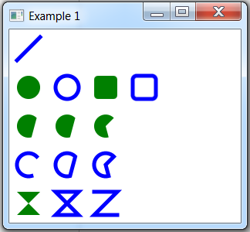
Canvas /Example01
Canvas object
Represents drawing area
Is an image
Has a graphics context
Graphics Context
Provides tools to draw on the Canvas

Slide 5
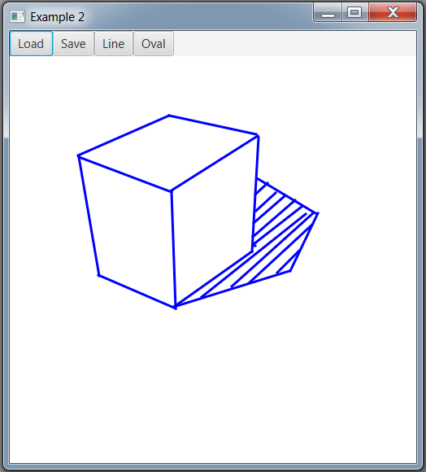
Canvas /Example02
Can handle events, just like any other control
Drawing application that
Draw either lines or ovals by dragging out shape
Stores shapes drawn so could be edited later
Allows loading and saving of drawn shapes
http://docs.oracle.com/javafx/2/ui_controls/file-chooser.htm

Slide 6

FXML

Slide 7

Programmatically creating UIs
Tedious
Possibly needs to be redone for other formats
Notes:
(devices, languages, …)

Slide 8
FXML
http://docs.oracle.com/javafx/2/fxml_get_started/jfxpub-fxml_get_started.htm
https://docs.oracle.com/javafx/2/get_started/fxml_tutorial.htm
XML description of UI & event handlers
Uses reflection to link controller, controller fields referring to controls & methods to be called when an event occurs
View & (Model + Controller) separated
Non-programmers can create UI
If change UI, don’t need to recompile, simply reload UI from FXML
Specialised tools
drag-and-drop UI editors exist to create FXML, e.g., SceneBuilder
IDEs can link with & generate code from FXML, e.g., IntelliJ

Slide 9
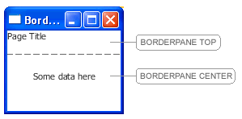

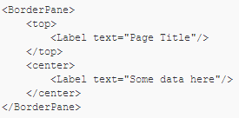
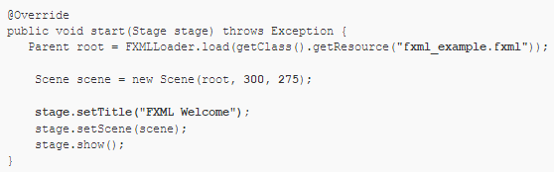
FXML PARTS
UI to be created
manually creates
describes
Programmatic Creation of UI
FXML Description of UI
Code to load FXML UI
automatically creates
from description
Notes:
Explicitly code each element and their placement (top left)
Right side and bottom
Right: Same UI described using FXML – XML-based markup language (why it is important to know XML)
Describe the UI in a declarative way instead of coding it manually
Bottom: Write some code to load the FXML file and display the UI
Builds the UI from the FXML
FXML – separates UI design from application logic
Build UIs more visually (if using a tool like SceneBuilder)
Cleaner, focused on logic, and not the layout

Slide 10
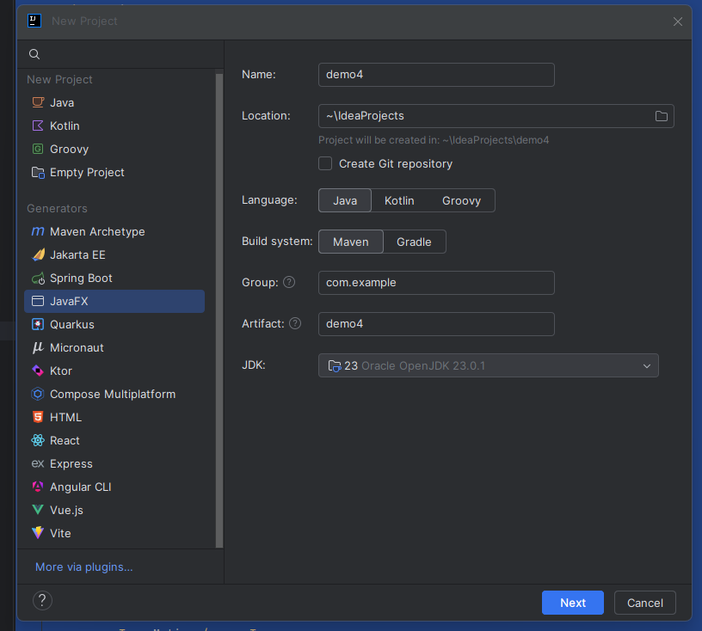
Starting an FXML application
Create a JavaFX application
Creates some internal links between FXML documents & code
Auto-generates some startup files for you
See tab at the bottom for SceneBuilder
Can switch between the two tabs

Slide 11
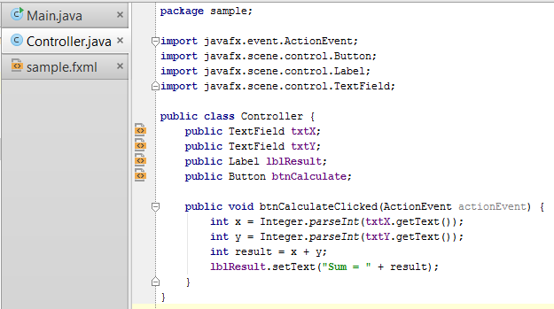
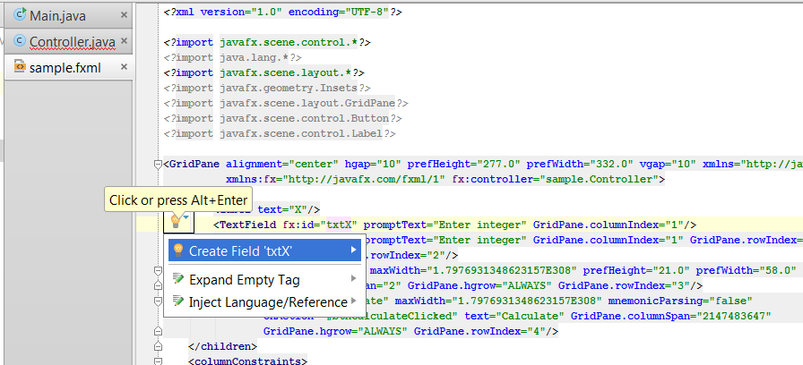
Create UI (in IntelliJ or Scene Builder)
To generate code from FXML
Open FXML document
For fx:ids of controls, select create field
For events, e.g., onAction, select create method
See /FXML-Examples
Imports needed for used controls

Slide 12
Setting up Bindings
May want to create bindings
After obtained references to controls
Before UI shown to user
Implement the Initializable interface

Slide 13

EXAM

Slide 14
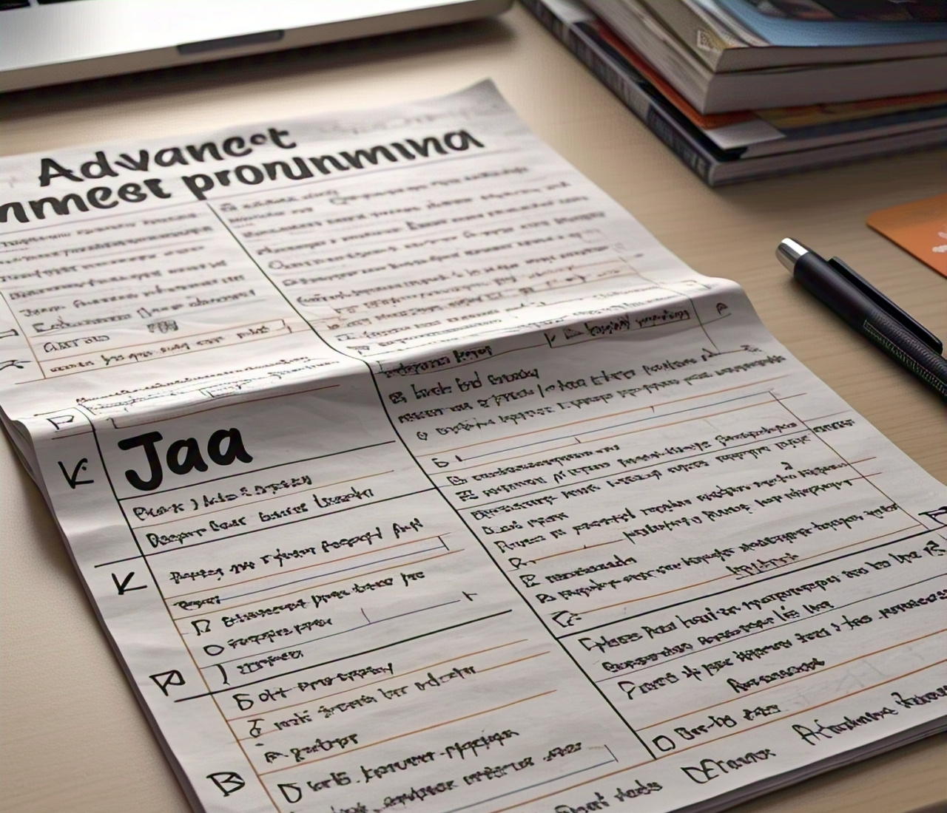
Exam
Remember to prep your cheat sheets
Double-sided, A4 page
Only allowed for practical session
Content
30% theory, 70% practical = 100 marks
All content
Logistics
??
Will be in the labs
Notes:
Please be there before start
T: drive
Copy from T: drive to local
Then save back
Read carefully – for Section B, read the entire question before answering
Look at the mark allocation

Slide 15
Exam
To prep
Theory
Slides (all lectures)
Practical
Slides (all lectures)
Examples
Assignments 1-4
Notes:
Use AI tools like ChatGPT → ask it questions & for some examples

Slide 16
Exam
Structure
Similar to tests
Class mark
Entry to exam: 40%
Final mark to pass: 50% (& need 40% in exam)
Final mark for re-exam: 45%
Notes:
Use AI tools like ChatGPT → ask it questions & for some examples

Slide 17
Exam
Remember that the exam & assignment environments are different, so not as scary as assignments 😊
The exam is not a warzone 😄
Notes:
Use AI tools like ChatGPT → ask it questions & for some examples

Slide 18
Summary
For practical
Can use SceneBuilder (& there will be help)
No custom controls or canvas drawing

Slide 19
Summary
Will test out environment in lab & setup instructions if needed
BUT your responsibility to make sure you know how it all works too

Slide 20
Notes:
Wanted to leave you with some thoughts on soft skills etc that I think can be important in the workplace
But then I thought no, I’ll see you in PV302, so I’ll leave it for then :D
Wish you all the best for your exams.
Visualise academic record – whatever you see your marks on with all distinctions or all passes depending on what you’re aiming for.
Work towards that during the exams.
That’s it for WRPV301 this semester! Thank you! Have a good week!

